Slide 1
Strategic Realignment within Smart Ecosystems
By Musabbir Chowdhury, Ph.D.
Productivity and Innovation Lab

Slide 2
On a typical day living in
Skype
Slack
Meetings
SMART Lifestyle
2
2.2
Lunch / social media
connects
Automatic door unlocks, heads up display
Alexa reads news.
Show weather.
Google nest provides direction
To the car.
1.3
2.1
Dinner ordered
Music by
Itunes/Spotify/ Google Play
Woke up by Amazon Echo/ Alexa
1.2
1
1.1
Nespresso Prodigio
SMART Coffeemaker
SMART Light bulbs turned on/off
TV / Read
3
Notes:
On a typical day those living “smart” lifestyles wake up with the help of an artificially intelligent virtual assistant running on an internet-connected speaker device. It plays their preferred songs from a music streaming service, and the smart lightbulbs in the rooms of their choosing are turned on automatically. Coffee is ready by the time they get to the kitchen, thanks to a Wi-Fi enabled smart coffee maker; The virtual assistant audibly delivers the weather forecast and reads the highlights of the day or provides any other information of the user’s choosing. A person’s car will open when approached by the owner it and will unlock the door with a simple touch by the authorized driver. Voice commands can launch real time traffic information and project the directions onto a “heads-up-display” on the windshield when the destination is announced by the driver. At work applications like GoToMeeting, Skype, WhatsApp, and Viber have become the norm for real time communication with clients, and emails are reserved for undertakings that are less urgent. During lunch people browse social media sites to connect with friends, family, colleagues, and clients. On the commute back home, dinner can be ordered using a phone app and food can be delivered from most restaurants soon after one is back in his or her home. After dinner, household necessities can be ordered from one’s phone using shopping apps, while some items may have been automatically re-ordered due to smart sensors in fridges and other internet-of-things devices. TV shows are watched on demand from various video streaming services, and magazines and newspapers are read on tablets or e-ink devices. The day ends when a smart watch informs the wearer it is time to sleep; as one heads to the bedroom the lights and TVs are turned off automatically by giving a simple audio cue to the virtual assistant.

Slide 3
Intelligent Technologies
Intelligent and Connected Technologies
SC
SMART Living
Tackle the problems associated with the growth of the world’s population and increasing urbanization.
Increase the quality of urban life.
Boost productivity of public services and reduce waste.
Reduce carbon emission.
+
+
+
+
+
“If policy makers and businesses get it right, linking the physical and digital worlds could generate up to $11.1 trillion a year in economic value by 2025.” (Ménard, 2017)
Notes:
With the emergence of intelligent technologies, smart-city initiatives have been growing around the world. Modern ICT shows promise in increasing the quality of urban life, boosting productivity of public services, and reducing waste. Government, academia, and industry have been working together to leverage modern ICT and improve the well-being of their citizens. Ménard (2017) found that “If policy makers and businesses get it right, linking the physical and digital worlds could generate up to $11.1 trillion a year in economic value by 2025.” In recent years, the European Union’s (EU) target to reduce 80% of carbon emission by 2050 as well as EU’s Smart Cities and Communities Initiative have inspired many European cities to develop innovative smart-city projects (Snow, Hakonsson, & Obel, 2016). Navigant Research’s Smart City Tracker (monitors 221 city projects around the world) expects “73 million connected street lights to be deployed globally by 2026” (Navigant Research, 2018). The nature of businesses within smart and shareable cities will certainly be different, but several of the strategic frameworks used for analysis and decision-making currently in use will still be applicable. One such framework is that of the Four Pillars of Productivity (4POP), which will be used to discuss how business should position themselves and operate in the new environment.

Slide 4
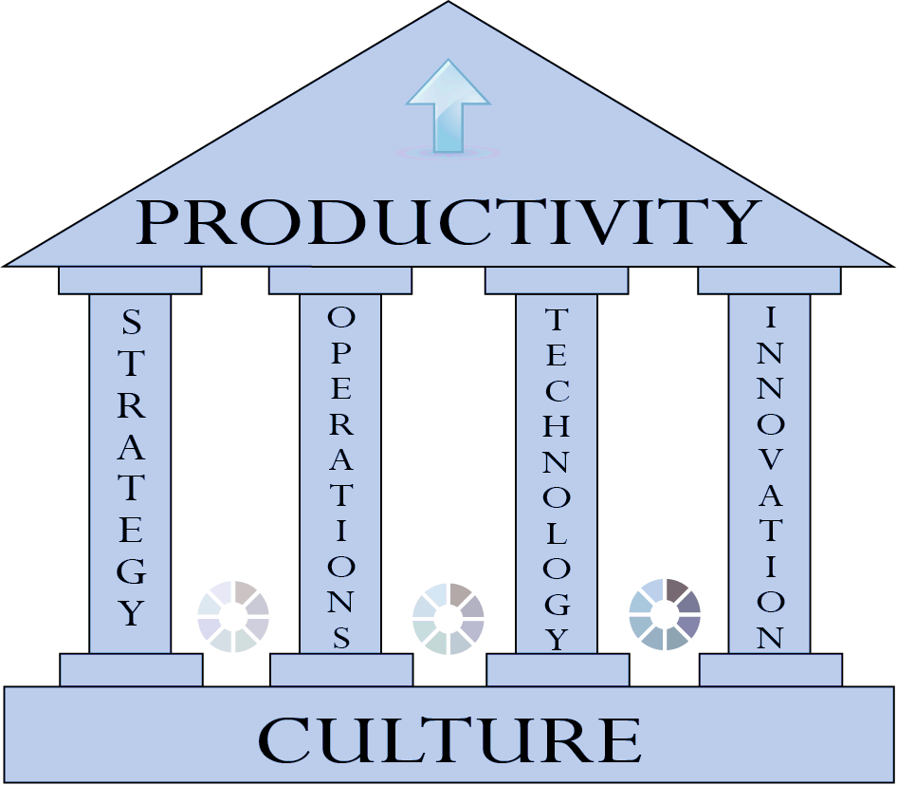
4POP FRAMEWORK
TECHNOLOGY
Technology sharing even now is becoming the norm, with cloud services and integration suites all online.
STRATEGY
Businesses in
Smart Cities have to lean towards greater differentiation
INNOVATION
OPERATIONS
With differentiation becoming even more important, innovation will likely company’s largest driver of value.
In Smart Cities there will be vast amounts of real time data, so operations timeframe will be measured in months at most.
FOUR PILLARS OF PRODUCTIVITY
CULTURE
Having a corporate culture that encourages continuous learning and fosters innovation is clearly a prerequisite.
Notes:
4PoP is a systematic framework developed to assist SMEs in aligning core business pillars allowing for rapid and sustainable productivity gains. The framework Four Pillars of Productivity (4PoP) includes: strategy, operations, technology, and innovation that stand upon a base of a supportive organizational culture. While most firms already have plans in place for strategy, operations, technology, innovation, and organizational culture, they are not always aligned in a manner that is conducive to productivity gains and overall business competitiveness (Chowdhury, 2016).

Slide 5
SMART CITY
Eco-System
+
Rapid development of digital technologies needs to be leveraged to create, capture, and deliver values for the entire ecosystem.
The technology, human, and institutional facets of smart ecosystems need to be aligned to improve quality of life, solve critical problems, and offer value to everyone (not just the rich, certain industries, or groups of companies).
+
+
Notes:
Smart cities are not just about ICT; human and institutional factors play a big role in shaping the future. Lea (2017) indicated that “a smart city is not just a city that leverages new technologies but is a complex ecosystem made up of many stakeholders including citizens, city authorities, local companies and industry and community groups.” Rapid development of digital technologies needs to be leveraged to create, capture, and deliver values for the entire ecosystem. The technology, human, and institutional facets of smart ecosystems need to be aligned to improve quality of life, solve critical problems, and offer value to everyone (not just the rich, certain industries, or groups of companies).

Slide 6
Notes:
Automation will be vital to the operations of a smart city. An important motivation for creating a smart city is to minimize the time people spend doing things which they do not enjoy. Most repetitive tasks fall into this category. For example, there are entire professions that are almost exclusively dedicated to monitoring areas. A security guard could spend 90% or more of their time checking various monitors for suspicious activity. Aside from the fact that people are not well equipped for such tasks to begin with, these jobs tend to be at night, which makes it even more likely even a hard-working and well-intentioned guard could make an error. A smart city with cameras can delegate this monitoring responsibility to artificial intelligence, which is extremely reliable at simple tasks such as monitoring if any activity is taking place in a room or area it should not be.

Slide 7
SMART CITY
Eco-System
Automation will be vital to the operations of a smart city.
An important motivation for creating a smart city is to minimize the time people spend doing things which they do not enjoy.
i.e. A smart city with cameras can delegate this monitoring responsibility to artificial intelligence, which is extremely reliable at simple tasks such as monitoring if any activity is taking place in a room or area it should not be.
+
+
+
+

Slide 8
Notes:
Energy and Infrastructure are necessary building blocks for the formation of a smart city. The consequences of a power outage in a smart city are much greater than in a traditional city, which will be discussed more in detail further on in the text. As such, a system that minimizes power outages is necessary. The use of renewable energy of course has myriad benefits, but in a smart city it can serve as a safety redundancy. The use of smart and microgrids, which are essentially smaller incarnations of a bulk power grid that are designed for a specific local purpose. They can, and usually do, link up to the larger power grid and will sell electricity to the larger grid when excess energy is generated and they will buy when there is an energy deficit.

Slide 9
SMART City Digital Connectivity
Notes:
Cities are now growing exponentially, which means there are more people, more cars, more pedestrians, and there is more demand for public services. However, people, cars, and cities are not currently talking to each other or sharing data on a meaningful scale. Microsoft recently announced new features for their Azure public cloud to support the location based geographical data needed to support smart cities, infrastructure, and IoT systems. Such a move towards building the integrated ecosystem would help to connect cities and infrastructure with road-utilising vehicles and the road-traffic infrastructure. Autonomous and connected cars would interact with the roads, traffic lights, and street signs. This would result in improved commute times, improved monitoring of pedestrians and vehicles to avoid accidents, and make the city both safer and more sustainable (Ravi, 2017). A recent Mckinsey analysis indicated that “the municipal setting is likely to be the second-largest beneficiary of IoT improvements with potential impact as great as $1.7 trillion by 2025” (Ménard, 2017).

Slide 10
CONCLUSION
ICT infrastructure and smart technologies of cities need to speak the same language.
Municipalities around the country need to collaborate and work with businesses and technology service providers to share their information in a standardized fashion.
A city with interconnected intelligent technologies will also face interconnected risks … a holistic approach to risk management will have to be adopted; all smart city players will have to collaborate to mitigate risk. … A generous annual budget for cybersecurity should be allocated.
Advanced data analytics can be embraced to improve the decision-making process for infrastructure maintenance, resource allocation, capital planning and so on.
Cities need to adopt systematic procurement and financing practices to support long term strategic priorities.
A smart city is not merely about adopting new technologies just to increase productivity or gross domestic product; new intelligent technologies need to be leveraged to create, capture, and deliver values to benefit the society at large.

Slide 11
iKajj - From IDLE to PRODUCTIVE!
“
Smart city players such as entrepreneurs, government, industry, and academia need to collaborate to foster social innovation to address issues related to urban expansion, inequality, diversity and inclusiveness, poverty, health, infrastructure, public services, and social instability. Put in its most simple terms, a smart city’s purpose is to improve all constituents’ quality of life.
”

Slide 12
THANKS FOR WATCHING
Phone : + 1 289 208 0801
Address : 135 Taylor Road, Niagara on the lake, Ontario, Canada
Email : mchowdhury@pi-lab.ca
Web : www.pi-lab.ca, www.musabbir.com

